Slide 1
Digital Logic Design Lab (CS-238)
Lab 1
Introduction to Laboratory Equipment’s and Component’s & Introduction to LOGISIM Software

Slide 2

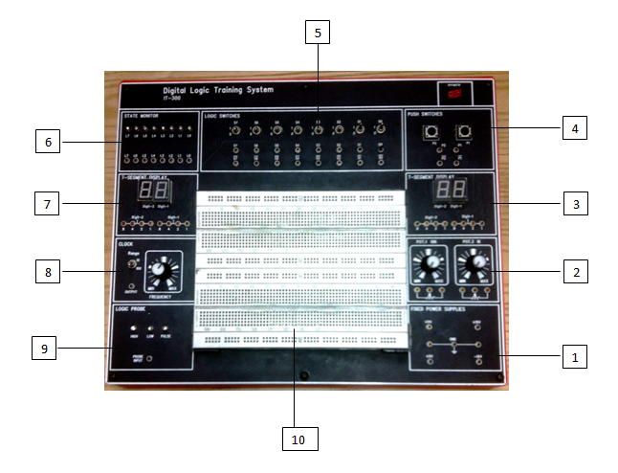
Part A: Introduction to Laboratory Equipment and Components
Notes:
Fixed Power Supplies
Voltage Range : +5V, +15V, -15V
With output overload protection
2. Potentiometers
Carbon Track, 1K and 10K
3. Seven Segment Display (A)
Two 7-segment LED displays with BCD to 7-segment decoder/driver
4. Push Switches
2 Independent switches, each with Q, Q’ output
5. Logic Switch
8-bit switch with complimentary TTL outputs
6. State Monitor
8 independent LEDs to indicate high and low logic state
7. Seven Segment Display (B)
Two 7-segment LED displays with BCD to 7-segment decoder/driver
8. Clock
1Hz – 64Hz
9. Logic Probe
“LO” and “HI” LED display low and high state respectively
10. Breadboard

Slide 3
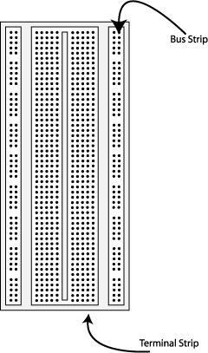
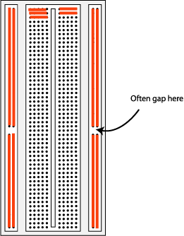
Breadboard:
1680 tie-point breadboard on top panel can be easily put in and taken off.
2 Terminal Strips, Tie-point 1280
4 Distribution Strips, Tie-point 400
Notes:
Breadboards are simply a set of pre-wired interconnects that aid you in the building of your circuits. By plugging a wire of one component into a hole you will connect it to all other components in that strip or bus. Using strips, buses, and jumper wires you can construct a circuit on your breadboard. You can tell which holes are connected in one node by the Colored lines connecting them in Figure. There are the component connection strips that run up and down and buses labeled with an A or B. After examining Figure the use of a breadboard should be clear.

Slide 4
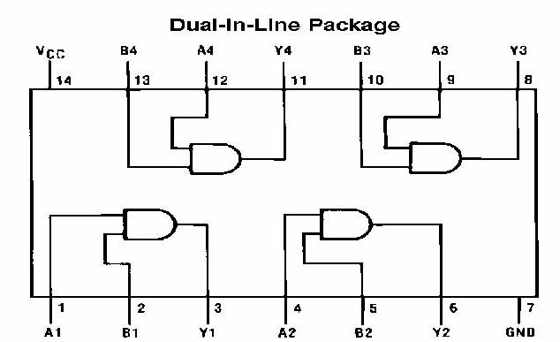
IC Logic Families and Characteristics
We have specified the logic level as either 0 or 1, or HIGH or LOW. In circuit implementation, we will have to specify the actual voltage/current levels that constitute a HIGH or a LOW. These standardized voltage/current levels are grouped in families of digital ICs so that ICs belonging to the same family will have the same characteristics.
Common families are
TTL: Transistor-Transistor Logic
ECL: Emitter Coupled Logic
IIL: Integral Injection Logic
MOS IC: Metal Oxide Semiconductor Integrated Circuits
In our Lab work, we shall use TTL Logic family that corresponds to 74LSxx series.
Notes:
Miniature, low cost electronics circuits whose components are fabricated on a single, continuous piece of semiconductor material to perform a high level function.
Usually referred to as a monolithic IC
First introduced in 1958
Categorized as digital or linear ICs or according to the level of complexity of the IC
Packaging
Protects the chip from mechanical damage and chemical contamination.
Provides a complete unit.
It is large enough for electrical connections to be made
Material is molded plastic, epoxy, resin, or silicone. Ceramic used if higher thermal dissipation capabilities required. Metal/glass used in special cases.
Three most common packages for IC are
Dual –in-line (DIP) most common
Flat pack
Axial lead

Slide 5
Part B: Introduction to LOGISIM Software
The Tutorial video is added in the same folder. Here is the link to folder:
https://drive.google.com/open?id=1sP9e476LzzOo41l-aqUqkP5_eaTHXaXd

Slide 6
Lab Tasks:
Simulate 3 basic gates and write your observations along with screen shots.
Complete the lab report with observations & review questions.

Slide 7
Learning Outcomes
Students will be familiarized with basic lab equipment and software tool to be used in this lab.

